Slide 1


Illumination Parts:- Lambert's Law (Ambient Light, Specular Light, Diffuse Reflection
School of Computer Science
University of Petroleum & Energy Studies
Bidholi, Via Prem Nagar, Dehradun, Uttarakhand
(AUG-DEC 2024)
BACHELOR OF TECHNOLOGY in
COMPUTER SCIENCE & ENGINEERING
Computer Graphics Presentation
Team Members:
AKSHAT NEGI : 500106533
AMEYA TANEJA : 500101975
HIMNISH MEHANDIRATTA: 500105446
AVNI KUBA: 500105234

Slide 2
01
ILLUMINATION MODAL
02
AMBIENT LIGHT MODEL
04
LAMBERT LAW
03
DIFFUSE REFLECTION MODEL
05
SPECULAR REFLECTION MODEL
T
CONTENTS OF THIS PRESENTATION
You can describe the topic of the section here
You can describe the topic of the section here
You can describe the topic of the section here
You can describe the topic of the section here
You can describe the topic of the section here

Slide 3
ILLUMINATION MODEL
T
Introduction
A projection describes only where an object has to be drawn on the projection plane.
The determination of visible surfaces also focused only on the question which objects should be drawn and which ones are hidden from view by others.
The information where an object should be drawn on the projection plane is not at all sufficient for a realistic representation of a 3D scene.
Realistic displays of a scene are obtained by generating perspective projections of objects and by applying natural lighting effects to the visible surfaces.

Slide 4
ILLUMINATION MODEL
T
Also called a lighting model or shading model
Model for calculating light intensity at a single surface point.
This is used to calculate the intensity of light that we should see at a given point on the surface of an object.
SURFACE RENDERING METHODS
Also called surface-shading methods.
Defined as a procedure for applying a lighting model to obtain pixel intensities for all the projected surface positions in a scene.

Slide 5
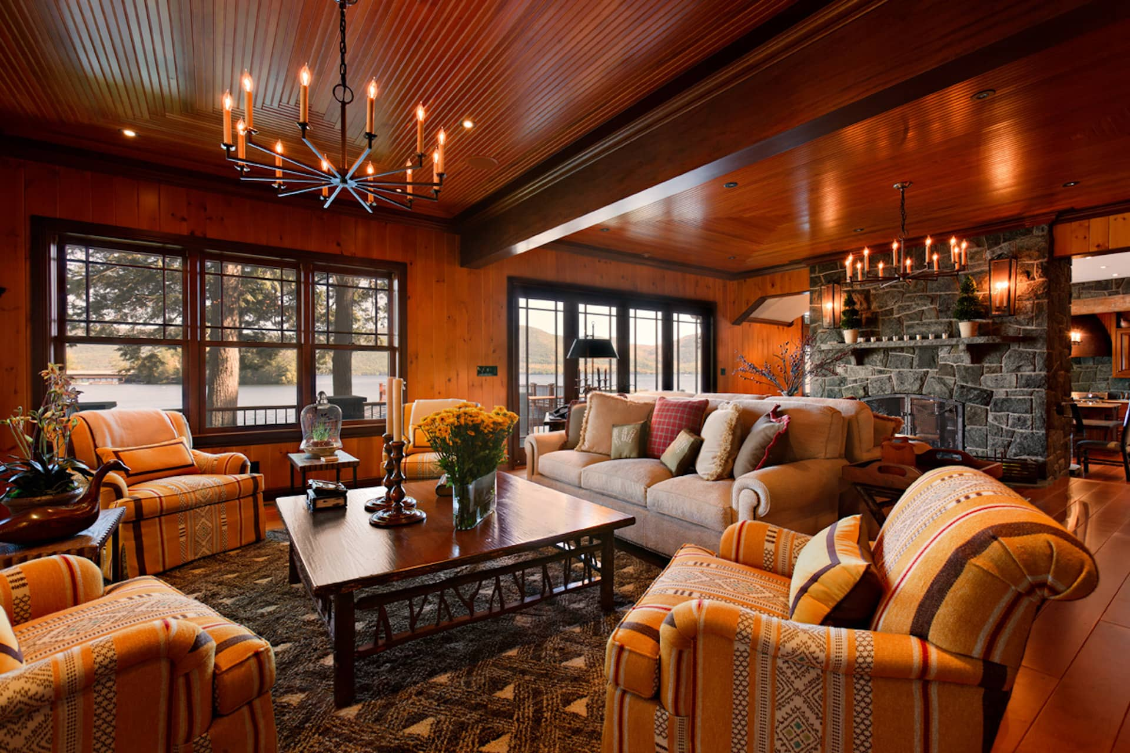
AMBIENT LIGHT ( I_{a} )
T
Ambient light has no spatial or directional characteristics.
The amount of ambient light incident on each object is a constant for all surfaces and over all directions.
The intensity of the reflected light for each surface depends on the optical properties of the surface; that is, how much of the incident energy is to be reflected and how much absorbed.
We can set the level for the ambient light in a scene with parameter I_{a} and each surface is then illuminated with this constant value.
The reflected intensity of Iamb of any point on the surface is
This is a simple way to model the combination of light reflections from various surfaces to produce a uniform illumination called the ambient light, or background light.
I_{amb} = K_{a} I_{a}

Slide 6
DIFFUSE REFLECTION (K_{d} )
T
Diffuse reflections are constant over each surface in a scene, independent of the viewing direction.
If there is a light source then different objects should have different intensities based on distance and orientation with respect to light source and viewer's position.
A point on a diffuse surface appears equally bright from all viewing position because it reflects light equally in all directions.
The fractional mount of the incident light that is diffusely reflected can be set for each surface with parameter kd, the diffuse-reflection coefficient, or diffuse reflectivity.
Parameter kd is assigned a constant value in the interval 0 to 1, according to the reflecting properties we want the surface to have.
If a surface is exposed only to ambient light, we can express the intensity of the diffuse reflection at any point on the surface as
I_{ambdiff} = k_{d} I_{a}
(where Kd is the diffuse-reflection coefficient)

Slide 7
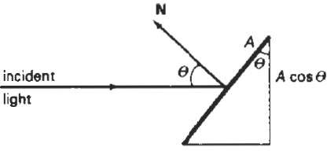
DIFFUSE REFLECTION ( K_{d} )
T
If we denote the angle of incidence between the incoming light direction and the surface normal as θ , then the projected area of a surface patch perpendicular to the light direction is proportional to cosθ.
If I_{L} is the intensity of the point light source, then the diffuse reflection equation for a point on the surface can be written as
I_{l,diff} = K_{d} I_{l} cosθ

Slide 8
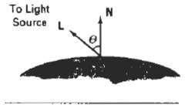
DIFFUSE REFLECTION ( K_{d} )
T
If N is the unit normal vector to a surface and L is the unit direction vector to the point light source from a position on the surface
(Fig. 14-9), then cos = N.L and the diffuse reflection equation for single point-source illumination is
We can combine the ambient and point source intensity calculations to obtain an expression for the total diffuse reflection.
In addition, many graphics packages introduce an ambient-reflection coefficient ka to modify the ambient light intensity Ia, for each surface.
I_{l,diff} = K_{d} I_{l} (N.L)
I_{diff} = k_{a} I_{a} + k_{a} I₁ (N.L)

Slide 9
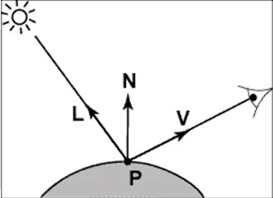
LAMBERTS LAW
T
Angle of incident between the unit light source direction vector L and there unit vectors normal N
This law states that when light falls obliquely on a surface, the illumination of the surface is directly proportional to the cosine of the angle (q) theta between the direction of the incident light and the surface normal N.
If I_{L} is the intensity of the point light source then, the diffuse reflection equation for a point on the surface can be written as
I_{L,diff} = K_{d} I_{L} (N.L)
OR
I_{L,diff} = K_{d} I_{L} cosθ

Slide 10
DIFFUSE REFLECTION ( K_{d} )
T
If light source is at infinite distance from the object then L will be the same for all points on the object, the light source becomes a directional light source
I_{diff} = k_{a} I_{a} + k_{a} I₁ (N.L)

Slide 11
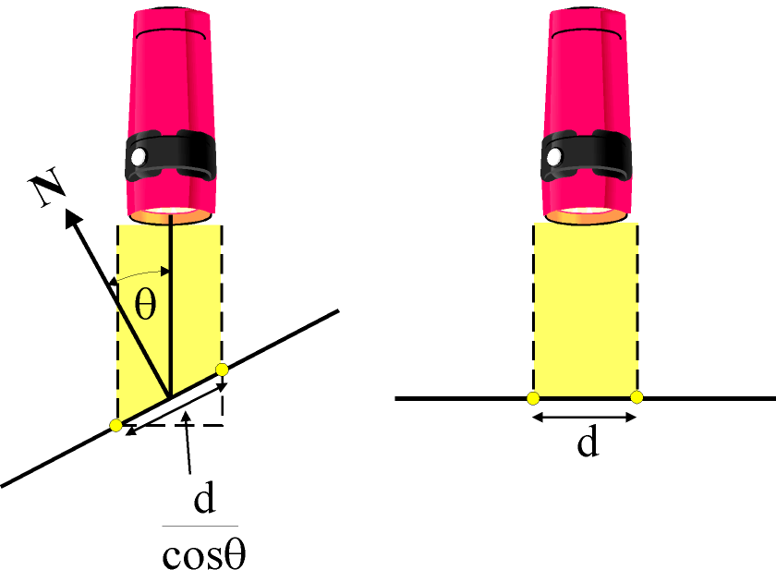
LAMBERTS LAW
T
A surface which is oriented perpendicular to a light source will receive more energy (and thus appear brighter) than a surface oriented at an angle to the light source.
The irradiance E is proportional to
As the area increase the irradiance decreases therefore:
As θ increases, the irradiance and thus
the brightness of a surface decreases
by cos θ

Slide 12
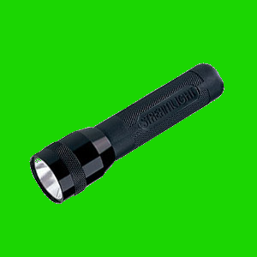
LAMBERTIAN ILLUMINATION MODEL
T
Intensity of reflected light depends on:
The angle the light rays make with the surface of the object θ
And the reflectivity (“colour”) of the object surface (k_{d})
The original colour of the light (L)
l
Graphical programs calculate light at each point using a simple formula
n
θ
θ is the angle between the normal and the light direction.
SO
Where l and n are unit vectors

Slide 13

DIFFUSE REFLECTION
T
The spheres above are lit by diffuse (k_{d}) values of 0.0, 0.25, 0.5, 0.75, 1 respectively

Slide 14
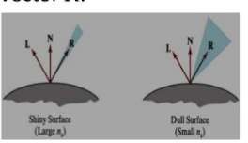
SPECULAR REFLECTION
T
When we look at an illuminated shiny surface, such as polished metal, an apple, or a person's forehead, we see a highlight, or bright spot, at certain viewing directions.
This phenomenon, called specular reflection, is the result of total, or near total, reflection of the incident light in a concentrated region around the specular reflection angle.
In this figure, we use N unit normal surface vector R to represent the unit vector in the direction of ideal specular reflection.
L to represent the unit vector directed toward the point light source.
V as the unit vector pointing to the viewer from the surface position.

Slide 15
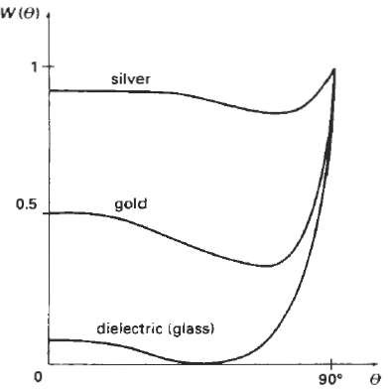
SPECULAR REFLECTION
T
The intensity of specular reflection depends on the material properties of the surface and the angle of incidence, as well as other factors such as the polarization and color of the incident light.
We can approximately model monochromatic iintensity for each specular variations using a specular-reflection coefficient, W(θ), surface.
I_{spec} = W(θ) I₁ COS^{ns} φ
specular-reflection coefficient, W(q) for different materials

Slide 16
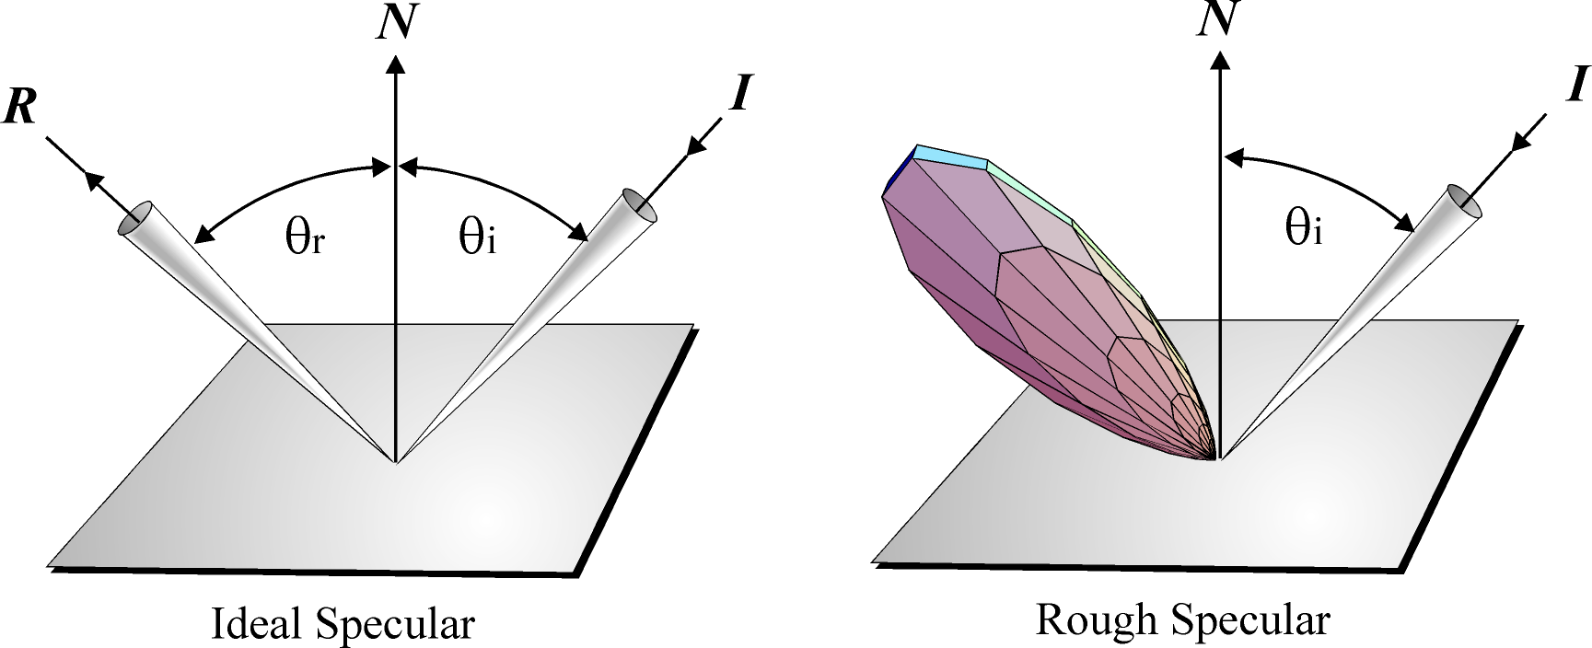
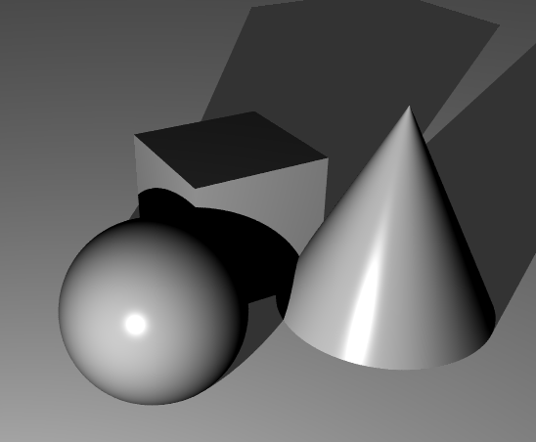
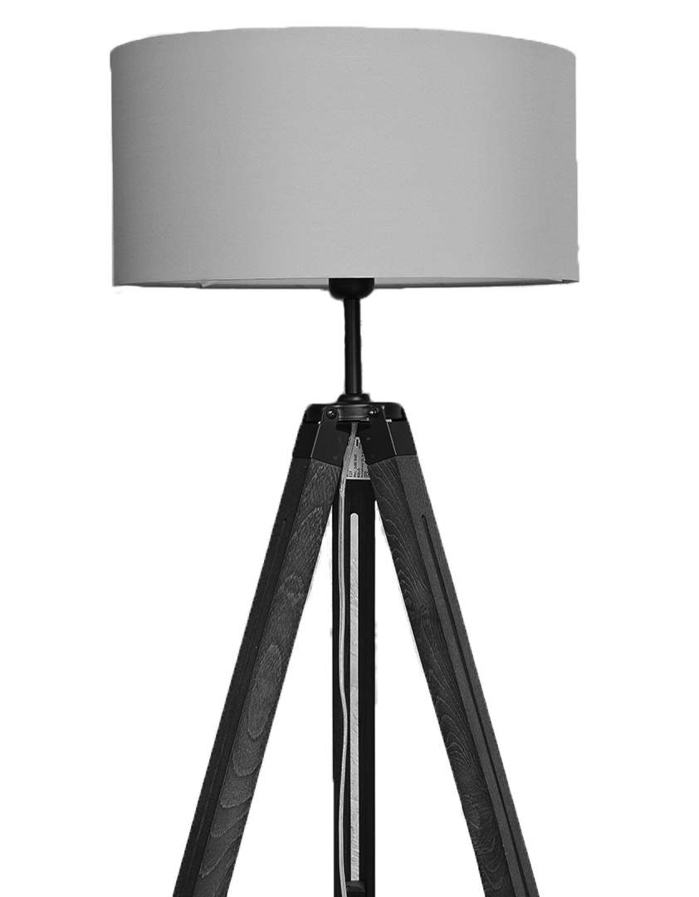
SPECULAR HIGHLIGHTS
T

Slide 17
Thank You
T
TEAM NUMER - 4

